Slide 1
Hacker Court

Slide 2
whoami - Winnona
Hacker Court organizer
Recovering threat analyst, law student
Policy@ Goon - DEFCON
—
Twitter: @__winn
Bluesky: @winn0na

Slide 3
The Dream Organizing Team
Emma Plankey - Student, HLS ‘24
Mari Dugas - Associate, Cooley LLP

Slide 4
Participants
CASE 1
Harley Geiger - Prosecution
Kurt Opsahl - Defense
Ian Roos - Witness
CASE 2
Mari Dugas- Plaintiffs Counsel
Kurt Opsahl - Defense
Silas Cutler - Defendant / Witness 1
Grant Versfeld - Witness 2

Slide 5
United States v. John Doe Researcher
Federal Criminal Case

Slide 6
Volunteer?

Slide 7
Statement of the Facts
Ransomware group has been exploiting a wormable RCE vuln.
John Doe finds a patch to this vulnerability, and instead of informing law enforcement, applies it at scale.
Notes:
Rapidly spreading destructive malware is found on an integral part of supply chain.
Individual actor finds a patch to this vulnerability, and applies it at scale. Patch bricks legacy system in a hospital, shutting down critical patient records and requiring the hospital to reroute patients for 72 hours.
Attacker accepts Pwnie Award the next year “for shits and giggles” (prosecution brings Pwnie organizer as witness). forensic reports from malware link to a cloud service registered under an account that shares cookies with his personal gmail. FBI was able to get a subpoena for the cloud service information. DOJ charges researcher with CFAA Violation.

Slide 8
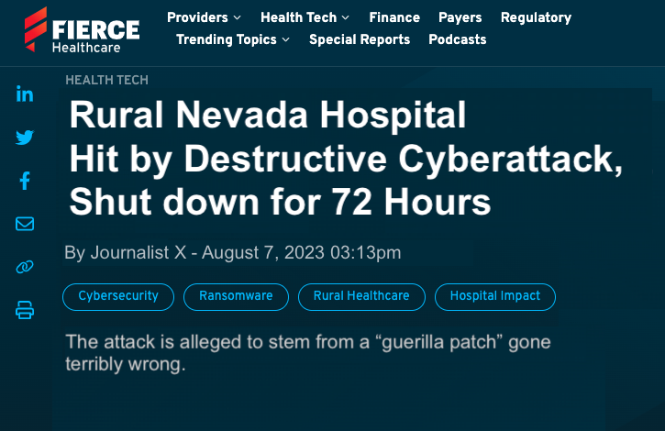
Notes:
Rapidly spreading destructive malware is found on an integral part of supply chain.
Individual actor finds a patch to this vulnerability, and applies it at scale. Patch bricks legacy system in a hospital, shutting down critical patient records and requiring the hospital to reroute patients for 72 hours.
Attacker accepts Pwnie Award the next year “for shits and giggles” (prosecution brings Pwnie organizer as witness). forensic reports from malware link to a cloud service registered under an account that shares cookies with his personal gmail. FBI was able to get a subpoena for the cloud service information. DOJ charges researcher with CFAA Violation.

Slide 9
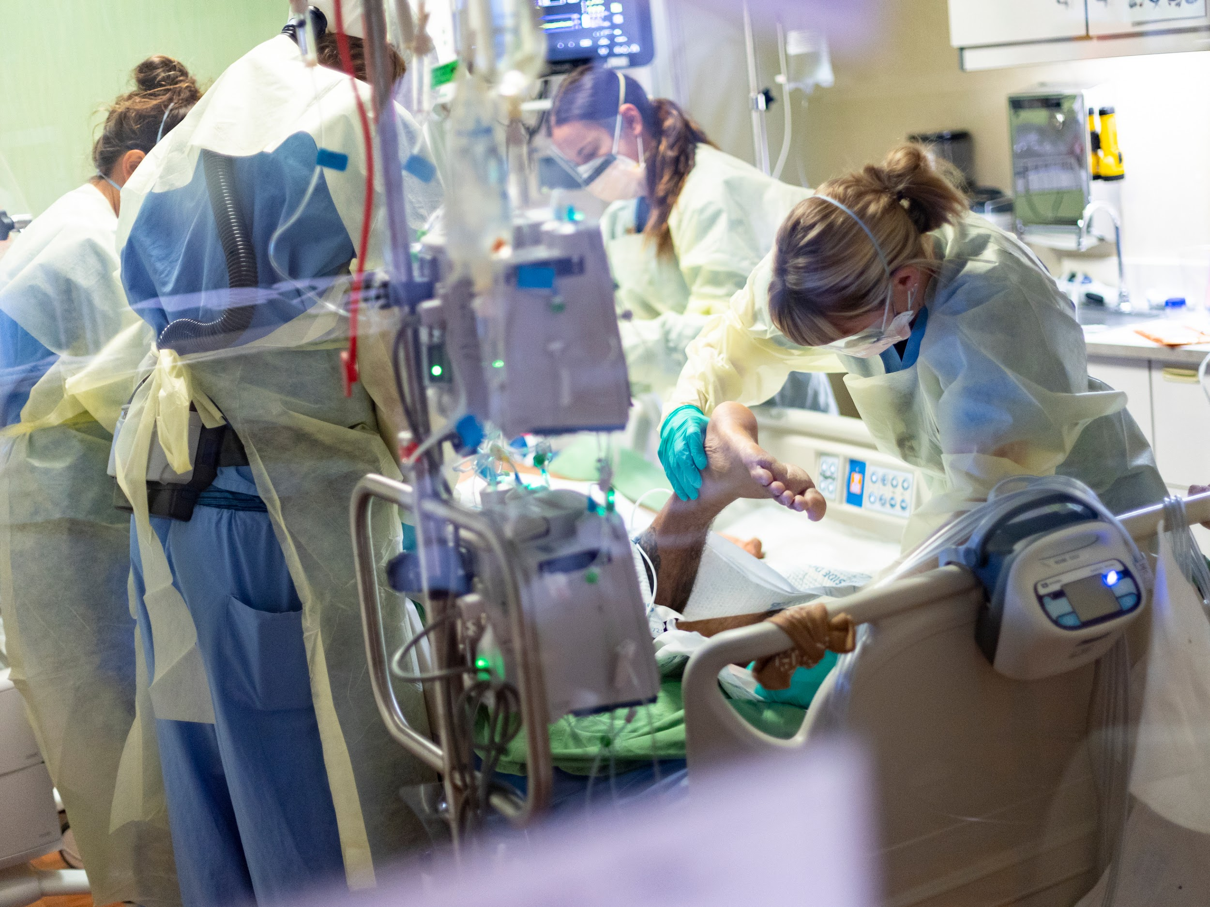
Notes:
Hospitals had to reroute patients, some of which were in critical condition.

Slide 10
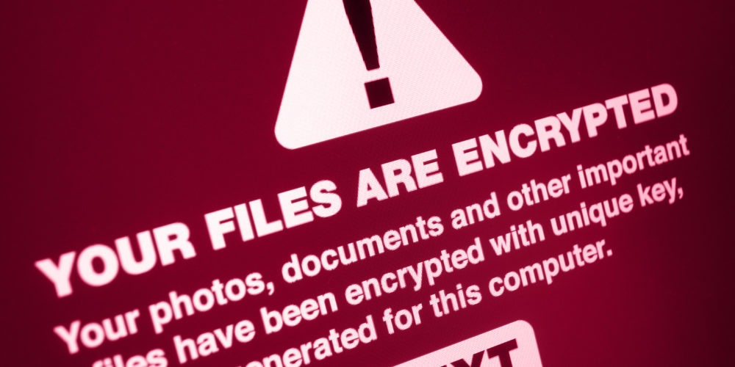
ITW 0day exploitation
0day exploitation in the wild (EGO Worm)
Ransomware / Triple Extortion. Exploit attached to implant, native checks for environment, specifically targeting financial institution software.

Slide 11
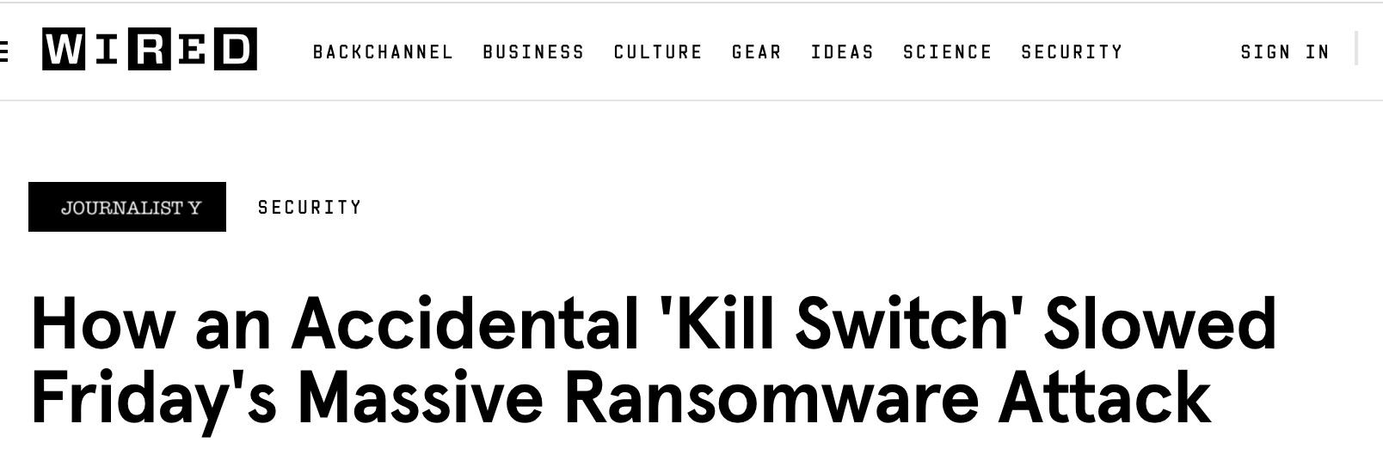

Slide 12
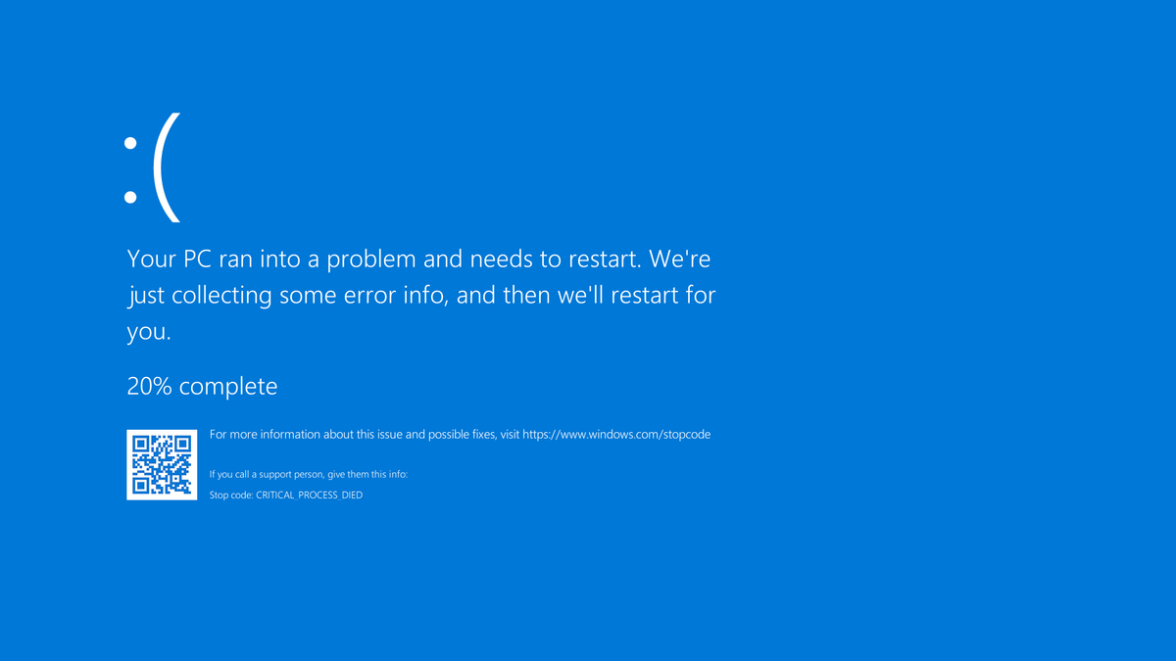
Notes:
Hospitals had to reroute patients, some of which were in critical condition.

Slide 13

Notes:
Pwnie award screenshot / an actual Pwnie

Slide 14
Charge: Computer Fraud and Abuse Act
18 U.S.C 1030(a)(5)(A) and (B): Whoever…
knowingly causes the transmission of a program, information, code, or command, and as a result of such conduct, intentionally causes damage without authorization, to a protected computer; or
intentionally accesses a protected computer without authorization, and as a result of such conduct, recklessly causes damage…
Shall be punished [with] a fine or up to 10 years of imprisonment.

Slide 15
Prosecution Opening Remarks
Reckless, damaging behavior, at Morris worm or NotPetya level scale.
Potential loss of life, when nobody asked him to do this.
Doe knowingly transmitted the program, and intentionally meant to change the registry key. Changes to a computer without user consent are “damage” under the law
Notes:
Rapidly spreading destructive malware is found on an integral part of supply chain.
Individual actor finds a patch to this vulnerability, and applies it at scale. Patch bricks legacy system in a hospital, shutting down critical patient records and requiring the hospital to reroute patients for 72 hours.
Attacker accepts Pwnie Award the next year “for shits and giggles” (prosecution brings Pwnie organizer as witness). forensic reports from malware link to a cloud service registered under an account that shares cookies with his personal gmail. FBI was able to get a subpoena for the cloud service information. DOJ charges researcher with CFAA Violation.
altering the configuration of a computer may be considered “damage” under 1030(e)(8) because it affects the “integrity” of the machine by changing it without the owner’s knowledge or permission.

Slide 16
Defense Opening Remarks
It is not a crime to be a good Samaritan - this guy is a hero.
Law enforcement was too slow, the EGO worm was wreaking havoc!
How can this be “intentional damage”, “reckless”, or “access?”
Defendant did not access any of these computers personally, their worm did.

Slide 17
Government Witness 1 - Ian, Security Researcher
Notes:
Prosecution: Talks about difference between the two worms Defense: “could have been targeted”
\Package exploit alongside (authentication protocol -> SMB / RDP) -> port scan validation + exploit code. [implant has no exploitation code, it has ability to execute shellcode. (routes exploit through [wormed where exploit is put on top of implant -> execution guardrails = looking for specific things). [Killswitch - innoculate their own machines against it, check if registry key exists. Worm exploits bug, adds registry key to make sure it won’t spread, won’t stop future infections. Exploitation is BSOD. [smb]
(stable from Win7 - Win11 , exists in Windows XP)

Slide 18
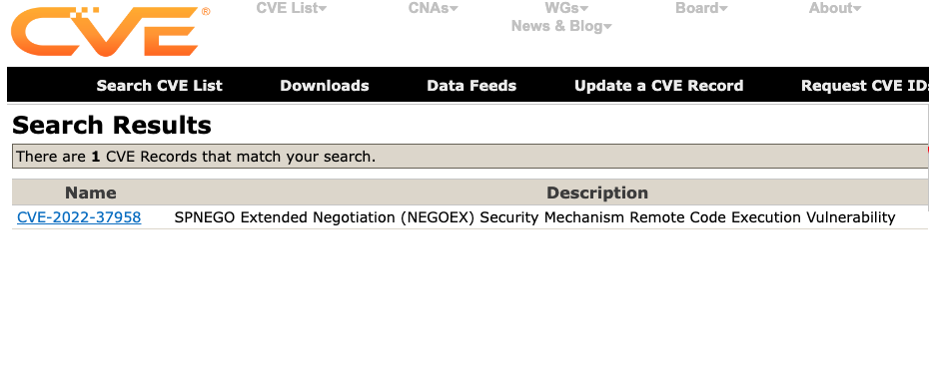
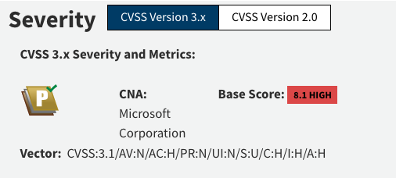
Notes:
Fake CVE screenshot

Slide 19
Notes:
Hospitals had to reroute patients, some of which were in critical condition.

Slide 20
Cross-examination
Notes:
Tell us what happened

Slide 21
Defense Witness 2 - Ian, Pwnie Award Organizer
Notes:
Tell us what happened

Slide 22
Defense Exhibit: Windows machines
1. Windows XP Machine:
Operating System: Windows XP Professional
CPU: Intel Pentium 4, 2.4 GHz
RAM: 1 GB DDR2
2. Windows Server 2019:
Operating System: Windows Server 2019 Standard
CPU: Intel Xeon E5-2620 v3, 2.4 GHz (6 cores, 12 threads)
RAM: 16 GB DDR4 ECC
3. Windows Server 2016:
Operating System: Windows Server 2016 Standard
CPU: Intel Core i7-7700K, 4.2 GHz (4 cores, 8 threads)
RAM: 32 GB DDR4
4. Windows Server 2012 R2:
Operating System: Windows Server 2012 R2 Standard
CPU: AMD Ryzen 5 3600, 3.6 GHz (6 cores, 12 threads)
RAM: 24 GB DDR4
Storage: 1 TB HDD (for lab data)
5. Windows Server 2008:
Operating System: Windows Server 2008 R2 Standard
CPU: Intel Core 2 Quad Q9550, 2.83 GHz (4 cores)
RAM: 8 GB DDR3
Storage: 500 GB HDD (for lab purposes)
Purpose: Familiarizing with older server environments.
6. Ubuntu Linux Machine:
Operating System: Ubuntu Desktop 20.04 LTS
CPU: AMD Ryzen 3 3200G, 3.6 GHz (4 cores)
RAM: 12 GB DDR
7. Network Attached Storage (NAS):
Operating System: FreeNAS or OpenMediaVault
CPU: Intel Celeron J4125, 2.0 GHz (4 cores)
RAM: 8 GB DDR4
Storage: 4 x 4 TB HDD (RAID 5 configuration)
8. Docker Host:
Operating System: CentOS 8 or Ubuntu Server 20.04 LTS
CPU: Intel Core i5-9600K, 3.7 GHz (6 cores)
9. PfSense Firewall:
Operating System: PfSense
CPU: Intel Pentium G4560, 3.5 GHz (2 cores)
10. Raspberry Pi Cluster:
Operating System: Raspbian or Ubuntu Server (for ARM)
CPU: Quad-core ARM Cortex-A72 (per Raspberry Pi 4)
RAM: 4 GB LPDDR4 (per Raspberry Pi 4)

Slide 23
Closing Arguments
PROSECUTION: Hacker is guilty beyond reasonable doubt
Patch wasn’t tested or ready and spread causing consequences.
chasing clout, caused damage
Exploiting an RCE is accessing / damaging a computer
DEFENSE: Hacker is not guilty, there is reasonable doubt of guilt
They mitigated other harms, they tested as much as they could
this was an unintended consequence
Authoring code is not accessing a computer

Slide 24

Jury Verdict
Is the Defendant guilty under the CFAA?
(i.e., was there intent to harm or recklessness?)
https://strawpoll.com/40ZmqxOxlZa
Or —---------------------------------------->
Notes:
TTP diagrams of malware, TTP diagrams of the patch (and why the patch messed stuff up)

Slide 25
(Likely) Judge Ruling
Guilty under CFAA.
Sentence reduced for good behavior, time served and probation.
Notes:
TTP diagrams of malware, TTP diagrams of the patch (and why the patch messed stuff up)

Slide 26
Telecom Co. v.
Offsec Start-up Inc.
Florida District Court, Civil Lawsuit

Slide 27
Statement of the Facts
Offensive security startup founded by 5 twenty-somethings with limited experience and a lack of corporate diligence and responsibility.
A bad actor purchased Offsec Startup tool (Entrylvl Toolkit) and cracked it.
Cracked version of EntryLvl provided initial access for a ransomware attack on Telecom Co.
Notes:
This is a case about the dual nature of offensive cyber tools and the imperative for companies who create such tools to ensure their products end up in the right hands.
In today’s case, you will meet the Defendants, five young men who, after limited experience in the cybersecurity industry, decided to write an offensive security tool, and sold their tool indiscriminately in pursuit of profit.
Today we will show that Defendants were aware that criminal enterprises had previously purchased and “cracked” the offensive tool. They aided and abetted a violation of the Computer Fraud and Abuse Act (CFAA).
On July 13, 2023, Telecom Co. experienced a ruthless ransomware attack, resulting in services going down for 6 hours in parts of the Southern U.S., resulting in a loss of over $75,000
A cracked version of the Offsec Software Start-up tool provided initial access.
This isn’t the first time Offsec Software’s tool has been used in cyber attacks; Offsec Software bears responsibility for the damages caused to Telecom Co.

Slide 28
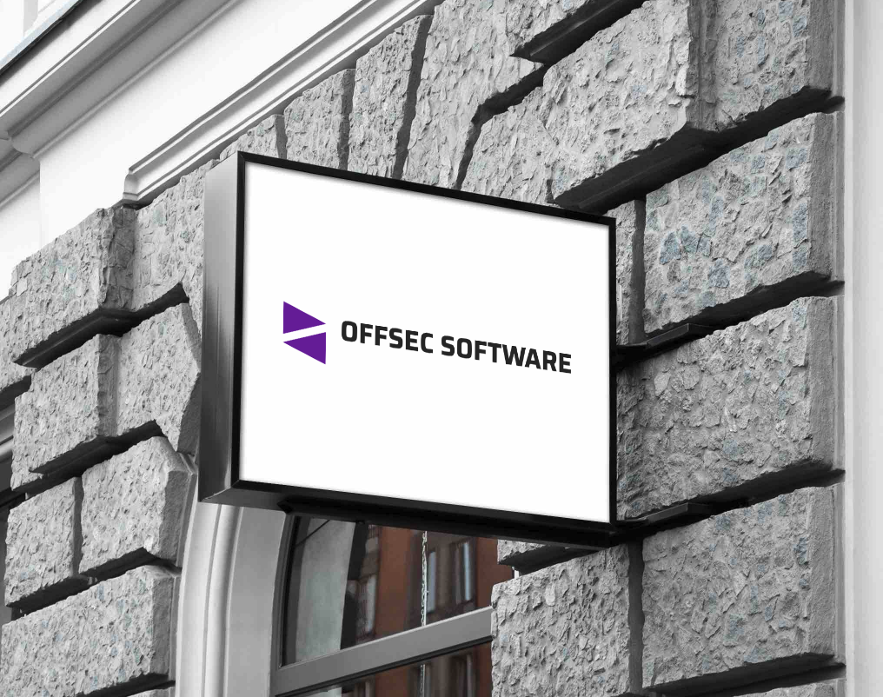
Marketing slide, fake contract, screenshot of a dark web forum post [cracked ver.]
Notes:
Legitimate company

Slide 29

Notes:
Legitimate company

Slide 30
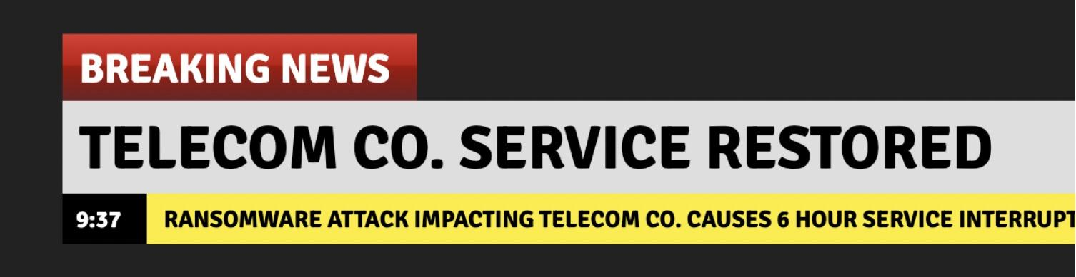
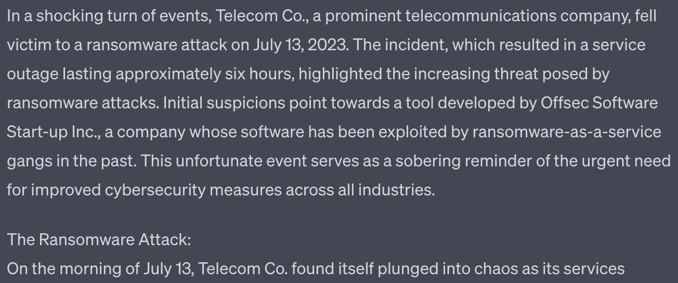
Notes:
My client followed its incident response plan and worked to restore its systems from backups. The attackers not only encrypted my client’s systems, but exfiltrated sensitive customer data and financial data, including confidential Q4 financial predictions, and threatened to leak the data on the darkweb if my client did not pay the ransom. My client does not negotiate with criminals and did not pay the ransom. The files were ultimately leaked on the darkweb and my client has seen its stock suffer as a result. Telecom Co.’s forensic report revealed that a cracked version of Defendants’ tool undisputedly provided initial access for the attack.

Slide 31
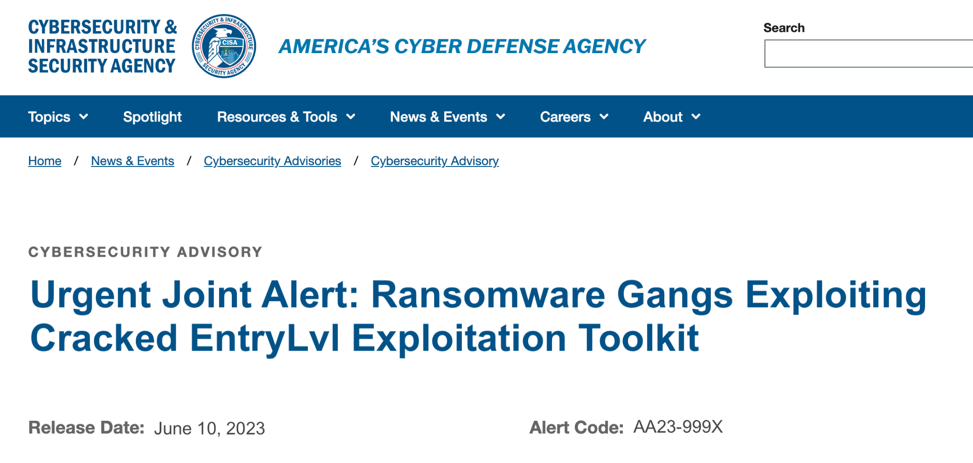
Notes:
**Specifically lists that the ransomware group is using fake news, including the one that was used to purchase EntryLvl.
This joint alert, issued by the Federal Bureau of Investigation (FBI) and the Cybersecurity and Infrastructure Security Agency (CISA), aims to raise awareness and provide crucial information regarding the escalating threat posed by ransomware gangs, particularly shad0wCrypt, who are actively exploiting a cracked tool obtained from Offsec Software Start-up Inc. The purpose of this alert is to ensure heightened vigilance, promote immediate defensive actions, and mitigate the risk of ransomware attacks targeting organizations and individuals.
The utilization of the cracked tool by shad0wCrypt and other ransomware gangs has significantly increased the risk and impact of successful attacks. Organizations and individuals who have failed to implement appropriate security measures and patches are at high risk of falling victim to ransomware attacks, resulting in data breaches, financial losses, and operational disruptions.

Slide 32
Claim: Aiding and Abetting (State Law)
Underlying Claim: Property Damage / Computer Fraud
(1) the party whom the defendant aids must perform a wrongful act that causes an injury;
(2) the defendant must be generally aware of his role as part of an overall illegal or tortious activity at the time that he provides the assistance;
(3) the defendant must knowingly and substantially assist the principal violation.

Slide 33
Plaintiff Counsel Argument
Ransomware gang clearly performed wrongful act;
Offsec Startup had prior knowledge of their offensive security tool being purchased.
Offsec Startup substantially assisted the ransomware group - Without EntryLvl, the ransomware gang would not have been able to harm Telecom Co.
Thus, Offsec substantially assisted in the CFAA violation

Slide 34
Defense Opening Remarks
This is good faith security research.
We don’t sue a store owner who sells a robber the hammer he uses to break a window.
OffSec Startup is a victim too!
Defendants conducted required due diligence, they didn’t have knowledge of the underlying unlawful act.

Slide 35
Plaintiff Counsel Witness 1: Offsec Software Co. CFO

Slide 36
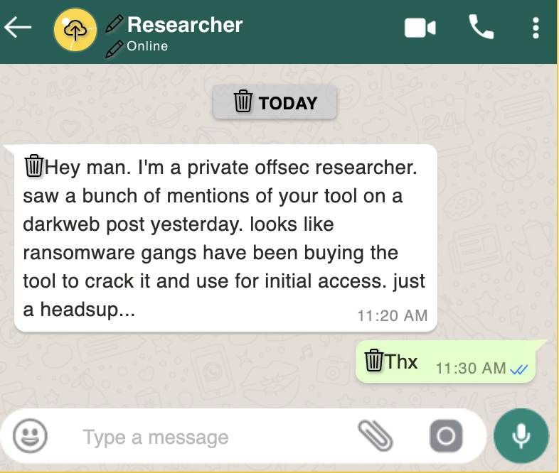
Plaintiff Exhibit 1: Private security researcher chat
Notes:
Offsec Software knew about the proliferation of their tool and its role in criminal cyber activities.
Exactly two weeks before shad0wCrypt bought the tool, a reputable security researcher reached out to Offsec

Slide 37
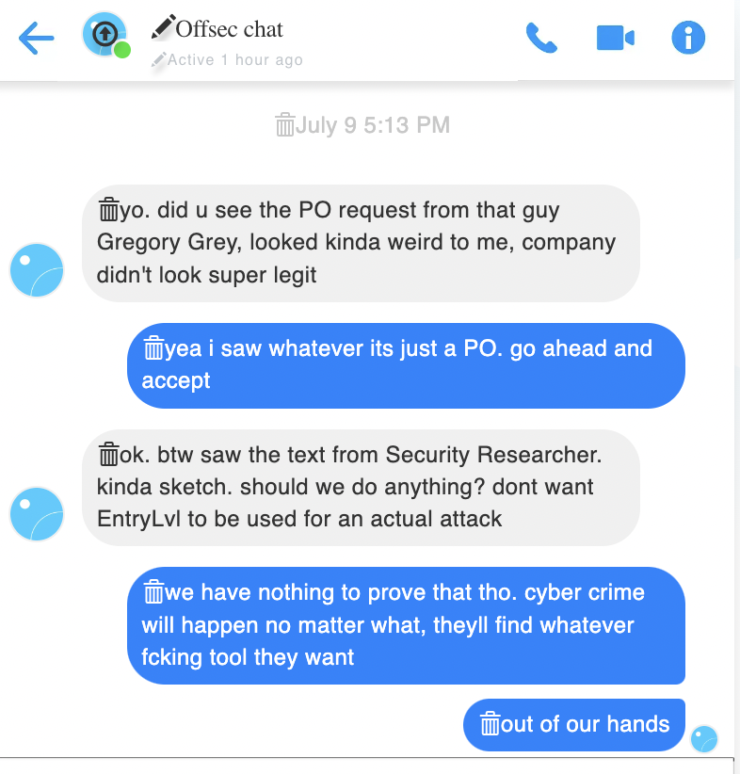
Plaintiff Exhibit 2: Internal Company Chat
Notes:
Text thread between defendants, showing (1) concern over the purchase of their tool and (2) awareness and disregard for the knowledge that the tool was being used by criminals

Slide 38
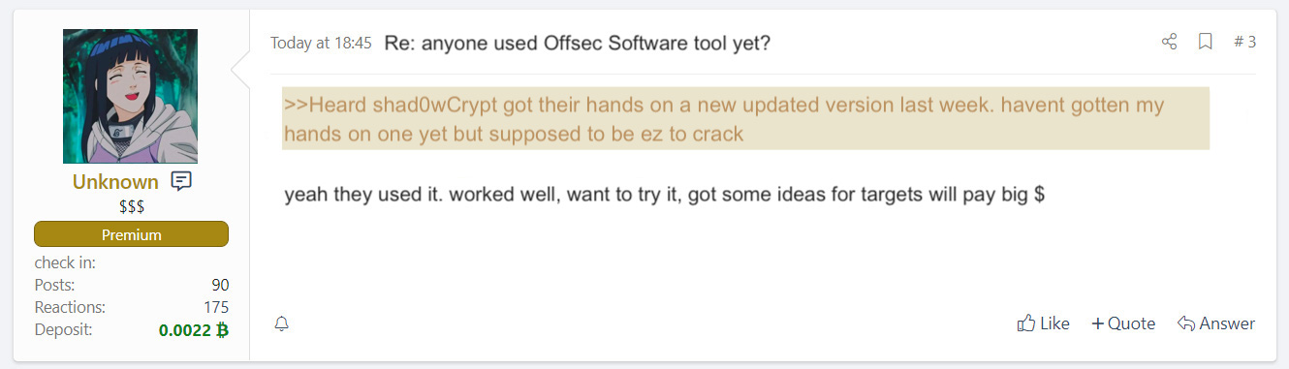
Plaintiff Exhibit 3: CSRF forum
Notes:
Screenshot of darkweb forum convo re cracked tool; was surfaced during discovery because a security researcher for a local university emailed the screenshot to Offsec’s CEO.

Slide 39
Cross examination

Slide 40
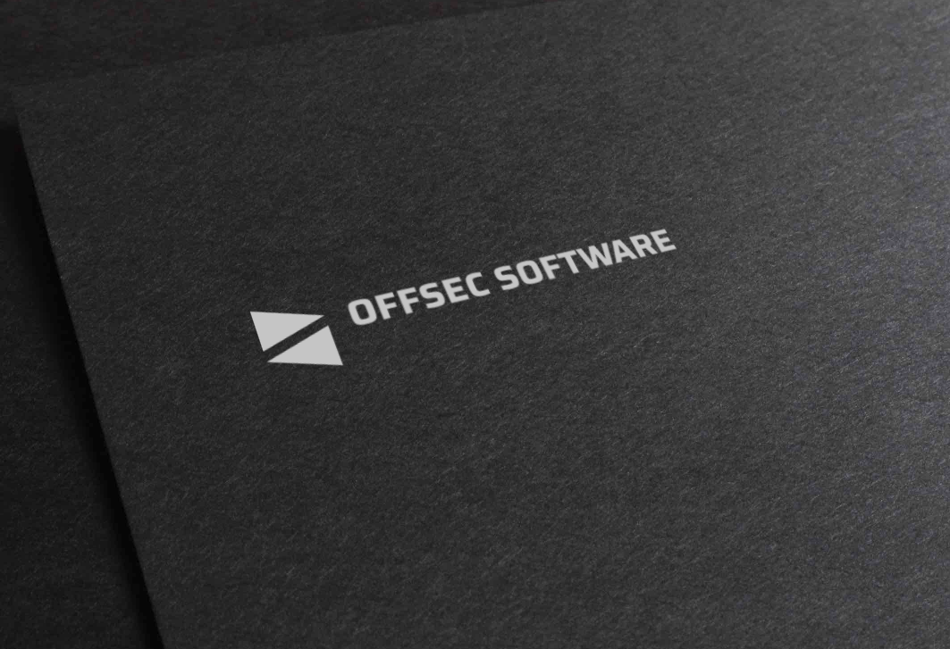
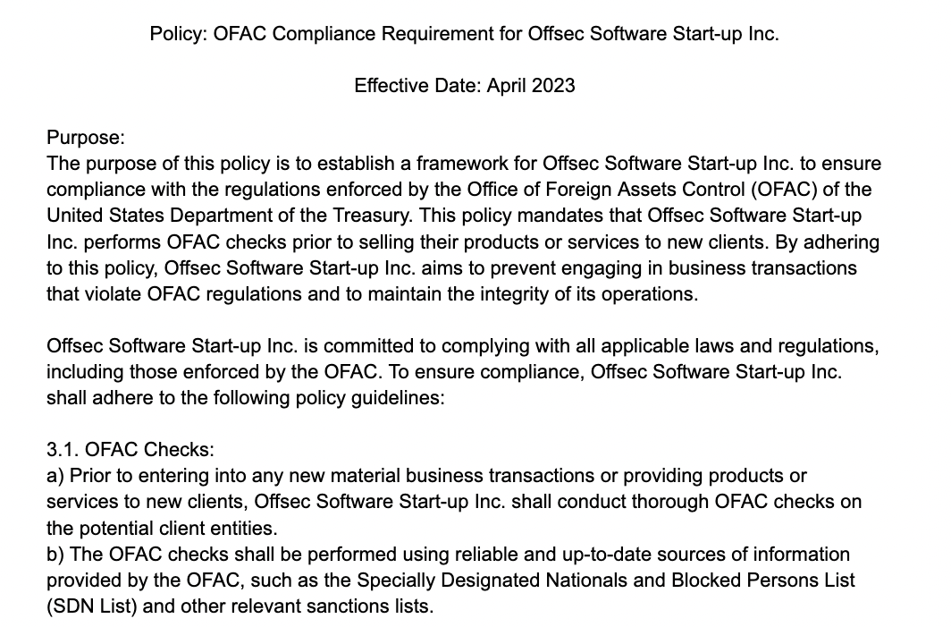
Defense Exhibit 1: OFFSEC OFAC Compliance
Company chat logs
Notes:
Compliance policy; someone likely ran an OFAC check (Judge questions efficacy of a thin policy and proof that an OFAC check was actually submitted)

Slide 41
Defense Counsel Witness 1: Special Agent Smith

Slide 42
Defense Exhibit 2: EntryLvl Product Description
EntryLvl is a cutting-edge security penetration testing tool designed to help businesses identify and address potential weaknesses in their IT infrastructure.
Developed by a team of expert ethical hackers and cybersecurity professionals, this state-of-the-art software is your first line of defense against malicious attacks and data breaches.
Notes:
Legitimate company

Slide 43
Cross examination

Slide 44
Plaintiffs Exhibit: Internal Company Chat
Notes:
Text thread between defendants, showing (1) concern over the purchase of their tool and (2) awareness and disregard for the knowledge that the tool was being used by criminals

Slide 45
Closing Arguments
PLAINTIFFS: There is 51% chance Offsec Startup aided and abetted the ransomware group:
Ransomware group caused injury;
Company was aware of their role in that injury; and
Company knowingly and substantially assisted by selling the tool.
DEFENSE: There’s less than 50% chance Offsec Startup aided and abetted
How is legitimate business knowing and substantial criminal assistance?
Company did not know, had could not have foreseen helping criminals
This has bad consequences on infosec industry

Slide 46

Jury Verdict
Q: Is it more likely than not that the start-up aided the ransomware gang?
https://strawpoll.com/BDyNEblbeZR
Or —----------------------------------------->

Slide 47
Judge Ruling
Judges’ discretion, potentially liable.
Notes:
TTP diagrams of malware, TTP diagrams of the patch (and why the patch messed stuff up)

Slide 48
Thank you!
Notes:
TTP diagrams of malware, TTP diagrams of the patch (and why the patch messed stuff up)

